Slide 1
Relationships… or the lack of!
Statistical Tests
COM527

Slide 2

Similarities and Differences

Slide 3
Comparing Data: Mann-Whitney Test
Determine if there is a statistically significant difference between two sample sets
Non-parametric statistical test
Assumes no knowledge of underlying population distribution
Or, that it is not a normal distribution

Slide 4
Comparing Data: Mann-Whitney Test
Method:
Gather data from both data sets and RANK it
Allocate the rank values back into the data sets
SUM the RANKS for each data set to give R
CALCULATE U value for each data set
SELECT smallest U value and compare to critical value table
U value is:

Slide 5
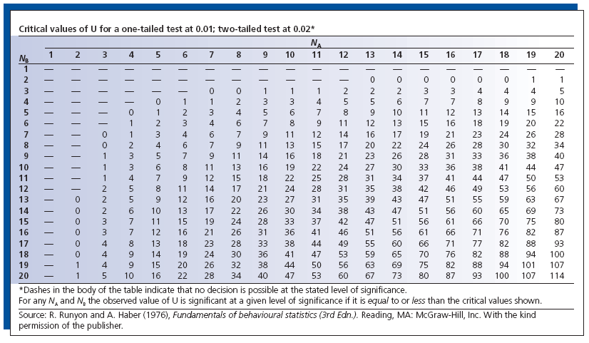

Slide 6
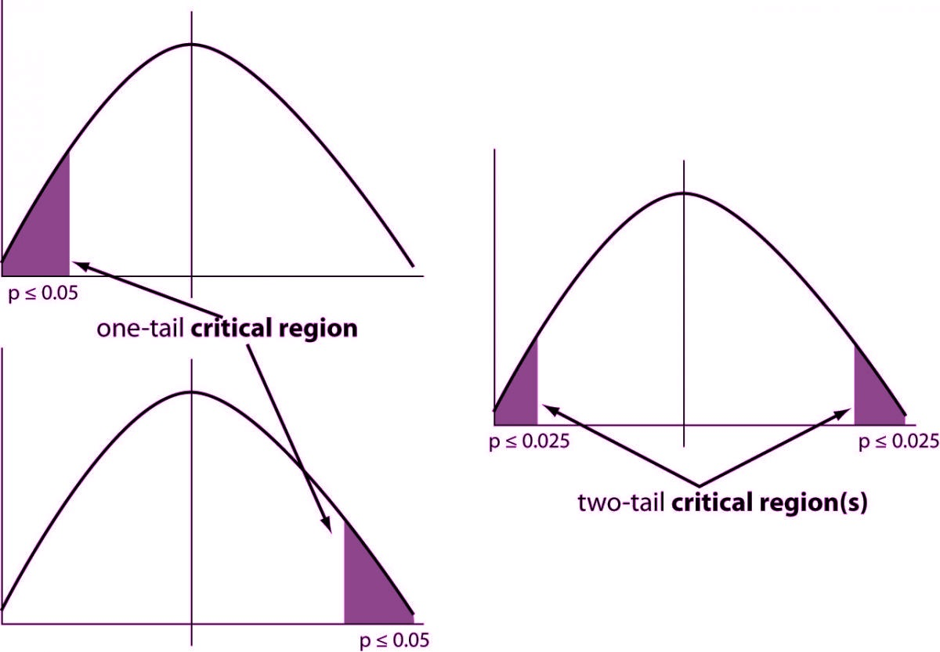
A tail of two cities …tails

Slide 7
Mann-Whitney Test Example 1
Suppose we deploy a survey, asking computing students and psychology students how much they enjoy a new computer game
They rate the playability of the game on a semantic differential scale:
1 = Very boring
10 = Very exciting

Slide 8
Mann-Whitney Test Example 1
We get the following results:
Computing Ratings | Psychology Ratings
5 | 7
4 | 9
1 | 3
2 | 6
7 | 10
2 | 8

Slide 9
Mann-Whitney Test Example 1
Rank the Values:
Computing Ratings | Psychology Ratings
5 (6) | 7 (8.5)
4 (5) | 9 (11)
1 (1) | 3 (4)
2 (2.5) | 6 (7)
7 (8.5) | 10 (12)
2 (2.5) | 8 (10)
* Note the split ranks where duplicates occur

Slide 10
Mann-Whitney Test Example 1
Sum the Ranks for each data set to get R:
Computing Ratings | Psychology Ratings
5 (6) | 7 (8.5)
4 (5) | 9 (11)
1 (1) | 3 (4)
2 (2.5) | 6 (7)
7 (8.5) | 10 (12)
2 (2.5) | 8 (10)
25.5 | 52.5
R:

Slide 11
Mann-Whitney Test Example 1
Calculate U values for each data set:
Computing Ratings | Psychology Ratings
5 (6) | 7 (8.5)
4 (5) | 9 (11)
1 (1) | 3 (4)
2 (2.5) | 6 (7)
7 (8.5) | 10 (12)
2 (2.5) | 8 (10)
25.5 | 52.5
R:

Slide 12
Mann-Whitney Test Example 1
Choose smallest U value and compare to critical value
Computing Ratings | Psychology Ratings
5 (6) | 7 (8.5)
4 (5) | 9 (11)
1 (1) | 3 (4)
2 (2.5) | 6 (7)
7 (8.5) | 10 (12)
2 (2.5) | 8 (10)
25.5 | 52.5
R:

Slide 14
Mann-Whitney Test Example 1
Choose smallest U value and compare to critical value
Computing Ratings | Psychology Ratings
5 (6) | 7 (8.5)
4 (5) | 9 (11)
1 (1) | 3 (4)
2 (2.5) | 6 (7)
7 (8.5) | 10 (12)
2 (2.5) | 8 (10)
25.5 | 52.5
Confidence interval = 0.02
Two-tail test
critical value = 3
U > critical value
Results not significant
(but would be at α=0.05)
R:

Slide 15
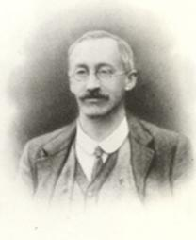
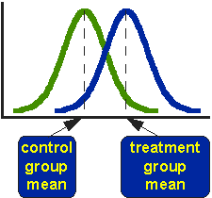

Comparing Data: t-Test
The t-Test is used to compare sets of results
Analysis of mean & variance
Parametric test = population assumed to be normal
Determine if they are from same population
E.g.- idealised normal distributions
William Gosset

Slide 16
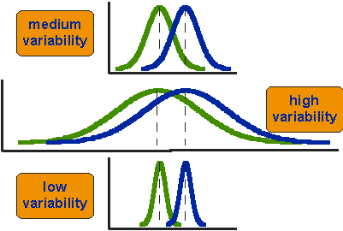
Comparing Results: The T-test
Are these from same distributed population?
Distance between means is static
‘mean-only’ analysis is weak!
Variance is of interest: overlap

Slide 17
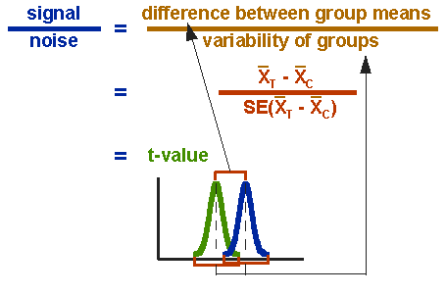

Comparing Results: The T-test
t-Test formula:
Where:

Slide 18
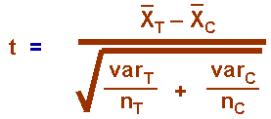
Comparing Results: The T-test
Complete T-test formula:
If t > tabulated value we conclude that the means are significantly different at that level of probability (α)
Reject the null hypothesis (the sample sets are insignificantly different)
i.e. the results differ / the ‘change’ has had an impact

Slide 19
t-Test Example
Suppose we are interested in comparing the efficiency of two computer systems.
We run a random selection of programs on Machine A and then another random selection on Machine B and measure the amount of time it takes (in seconds) for each program to run.

Slide 20
t-Test Example
We get the following results:
Machine A
n = 12
Mean = 77.3
St.dev = 46.4
Machine B
n = 12
Mean = 111.4
St.dev = 18.9
Machine A | Machine B
78 | 102
43 | 98
89 | 117
63 | 92
27 | 132
78 | 145
113 | 134
45 | 102
203 | 99
86 | 129
45 | 91
58 | 96

Slide 21
t-Test Example
We apply the t-Test to determine if the difference in the groups is significant
We decide upon a 0.05 confidence interval
df= 22
t = 2.3569
Using a two-tail test
A≠B
Tests A>B and A<B
Machine A | Machine B
78 | 102
43 | 98
89 | 117
63 | 92
27 | 132
78 | 145
113 | 134
45 | 102
203 | 99
86 | 129
45 | 91
58 | 96

Slide 22
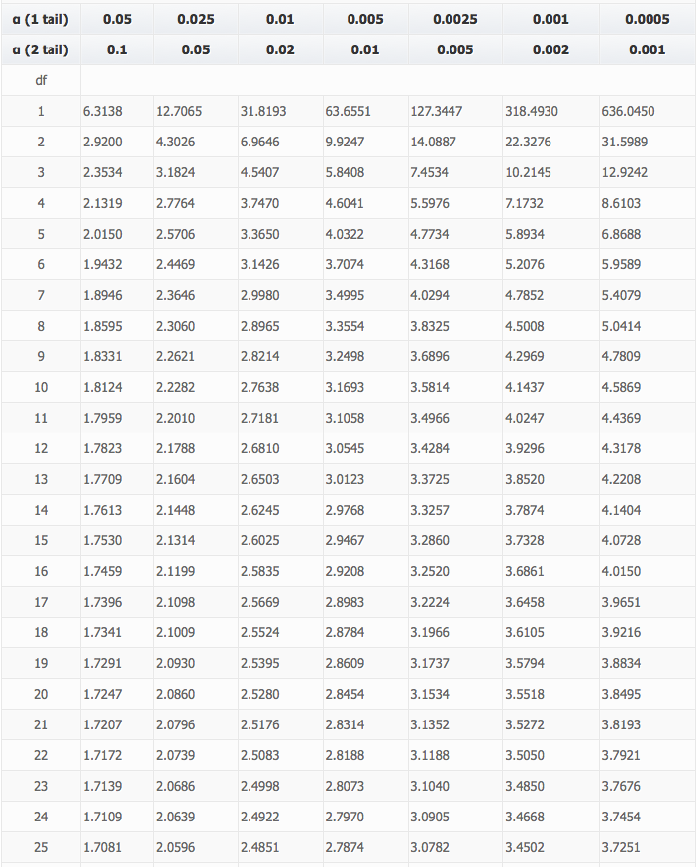
Comparing Results: The t-Test
Degrees of freedom
α = probability of error
In this example α=0.05
t = 2.3569
In this case, the result is significant
Since t > critical value

Slide 23
One and Two-Tail Critical Values

Slide 24

Correlation

Slide 25
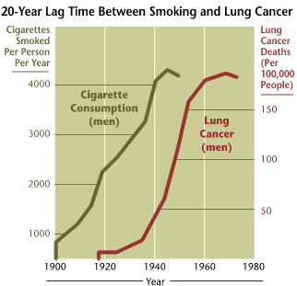

Determining if a relationship exists between multiple variables

Slide 26
Correlation & Regression
Correlation describes whether variables which describe a subject are related
e.g. does fat intake correlate with heart disease?
e.g. does download speed correlate with the number of servers in a cluster?
e.g. does number of cigarettes smoked correlate with number of lung cancer deaths?
Regression is the determination of a mathematical expression of the correlation
For example:

Slide 27
Correlation
A Pearson correlation co-efficient is calculated from the data sets (X and Y)
Where covariance is:

Slide 28
Correlation
Correlation ranges
r(X,Y)=0: there is definitely no correlation;
r(X,Y)= ±1: there absolutely is a correlation;
Is a correlation significant or the result of chance?
Depends upon sample size (degrees of freedom)
Rule of thumb r>±0.7 ≈ strong correlation
Methods available to ascertain significance

Slide 29
+’ve and –’ve correlations
r=0.947
r=-0.913

Slide 30
Correlation Example
Number of logged-in users vs. mean packet delay (ms) on an intranet
r=0.91

Slide 31
Correlation Example
Number of logged-in users vs. mean packet delay (ms) on an intranet
r=0.91

Slide 32
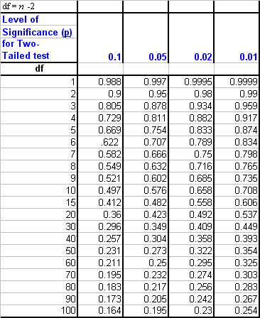
Correlation
Correlation significance testing allows evaluation of strength with a confidence interval
r > critical value = correlation is statistically significant
http://www.danielsoper.com/statcalc3/calc.aspx?id=44

Slide 33
Correlation & Regression
Example:
r=0.73
N=18
df=16
P<0.01

Slide 34
Correlation & Regression
Example:

Slide 35
Correlation & Regression
Can be used to predict values not sampled
Linear trend:
y=0.071 * x – 0.87
What if height is?:
66 = self-esteem 3.82
(0.071*66)-0.87
73.5 = self-esteem 4.35
37 = self-esteem 1.78
…and so on…

Slide 36
Correlation
Suppose we are interested in seeing whether the attendance of students to computing classes is related to the grades they achieve
We take a historic look at student module grades (%) and their attendance at the module classes (%)

Slide 37
Correlation
We obtain the following data:
Student | Attendance (%) | Grade (%)
A. Catt | 22 | 18
A. Lovelace | 76 | 46
A. Turing | 82 | 54
B. Gates | 46 | 30
G. Moore | 67 | 38
J. Bloggs | 30 | 25
J. Nash | 87 | 56
J. Newman | 97 | 78
J. Von Neumann | 95 | 65
K. Croston | 100 | 72
K. Pietersen | 68 | 40
L. Euler | 94 | 58
S. Jobs | 65 | 34
S. Wozniak | 70 | 43

Slide 38
Correlation
We plot the data:

Slide 39
Correlation & Regression
We plot the data:

Slide 40
Correlation
Check the correlation:
r=0.942
n= 14
Confidence interval of 0.05
p(two-tail)=0.00000047
p<0.05, so relationship is significant

Slide 41
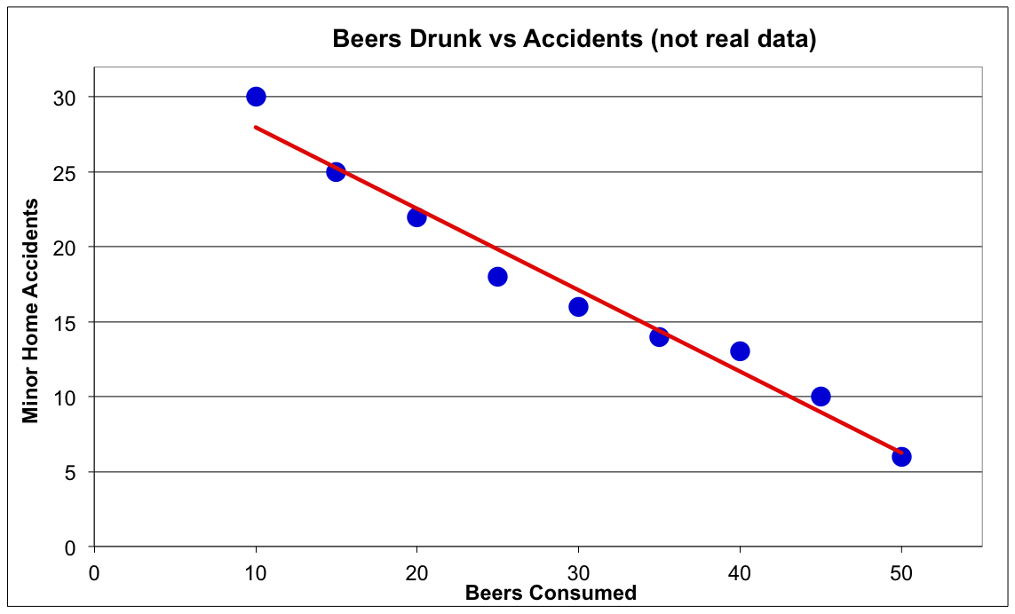
Correlation & Causality
r = -0.9869
What’s wrong with this picture?

Slide 42
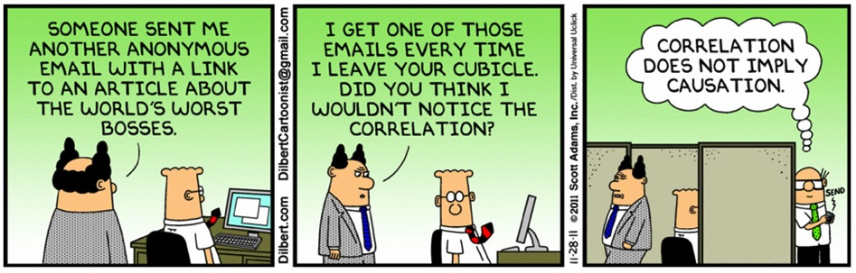
Correlation & Causality
Correlation does NOT imply causation! (0 – 2m 45s)
…but causation can be investigated separately

